Slide 1
Longest Common Subsequence
Jackie Gan
CIS 5511

Slide 2
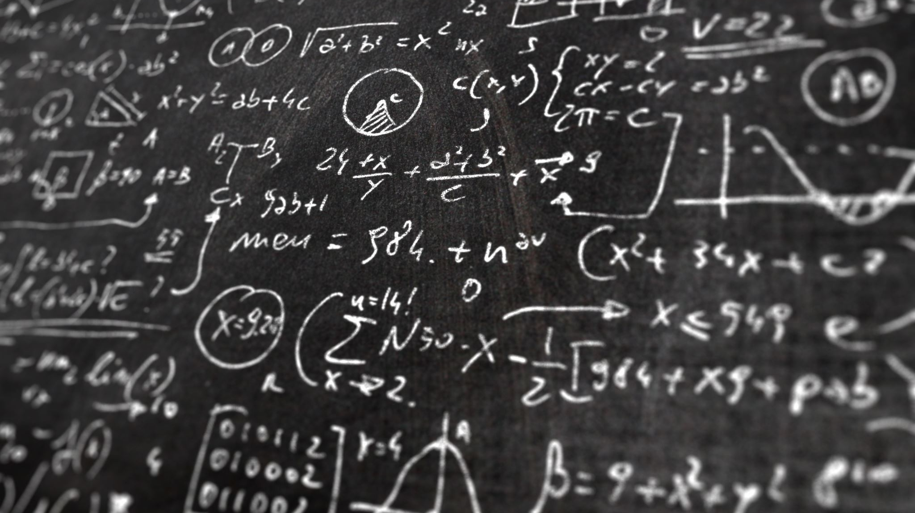
What is the purpose of this algorithm?
The Purpose of this algorithm is to find the longest matching sequence between two input arrays.
For Example:
Input 1 = ABCD
Input 2 = ACBAD
Longest Common Subsequence is ABD or ACD

Slide 3

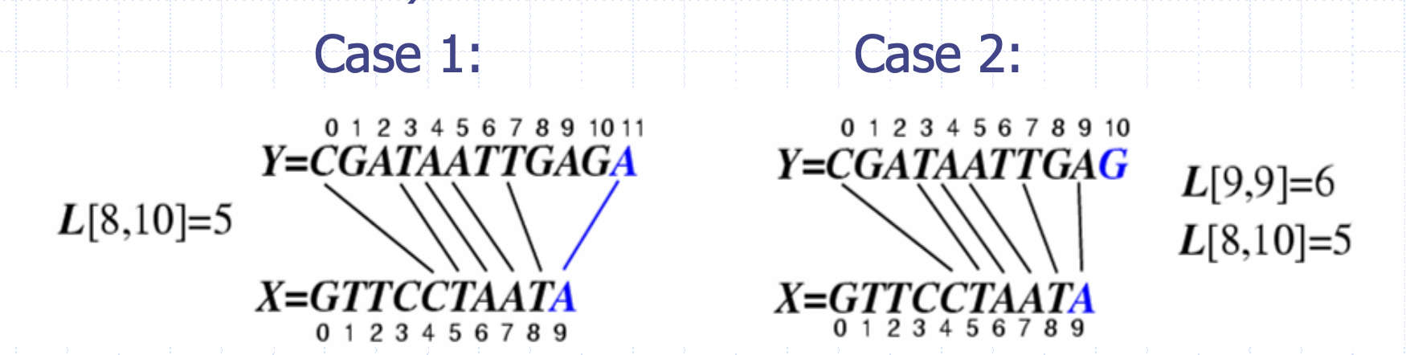
What are some applications?
For example, find the matching sequence with the DNA sequences given

Slide 4
What Does the Algorithm look like?

Slide 5
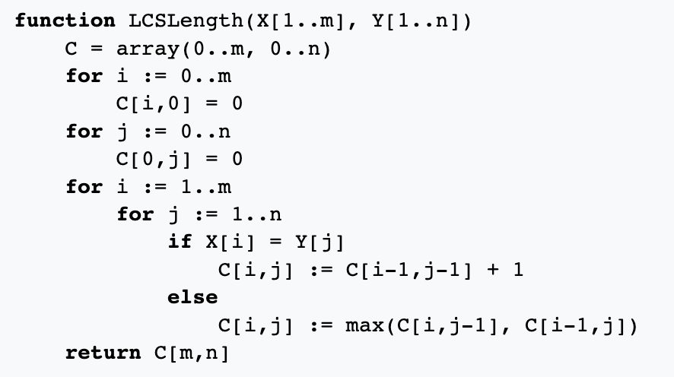
There are two approaches to the algorithm. In this slide we will talk about the dynamic programming version.
First, we construct one matrix, set both horizontal and vertical index 0 with element 0
Then , we go through the matrix to find a match set it to add 1
if not find the max element from the diagonal, top element and left left element

Slide 6
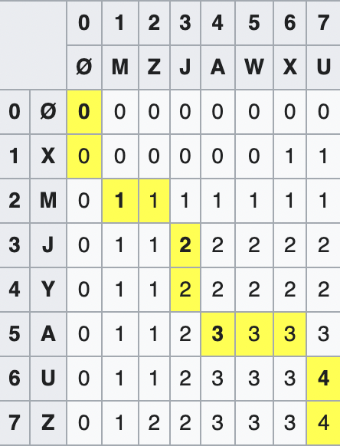
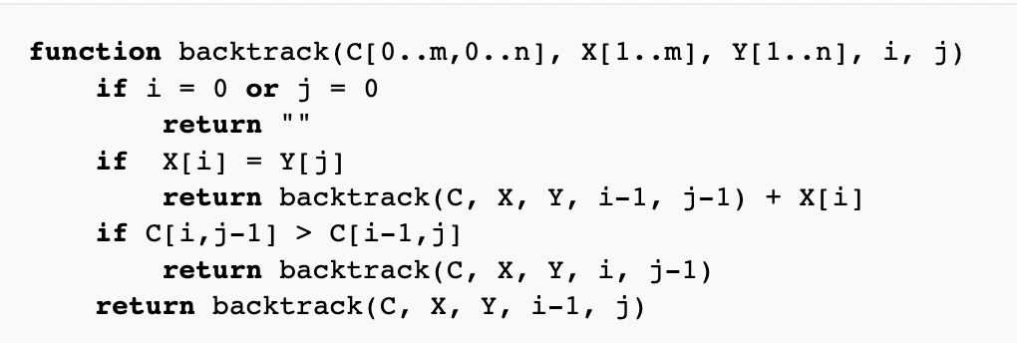
Matrix output and reading the matrix
Suppose X is XMJYAUZ and Y is MZJAWXU
Then the matrix would look something like this
But how do we read it?
We use backtracking
We recursively find where we got the element from the last element

Slide 7
What is the time complexity?
From the algorithm as we can see there is two for loops that searches through the whole matrix.
One is dependent on M
One is dependent on N
Thus O(n*m) is the time complexity

Slide 8

Thanks for listening

Slide 9
Source:
https://en.wikipedia.org/wiki/Longest_common_subsequence_problem
Wikipedia Longest Common Subsequence

